Slide 1
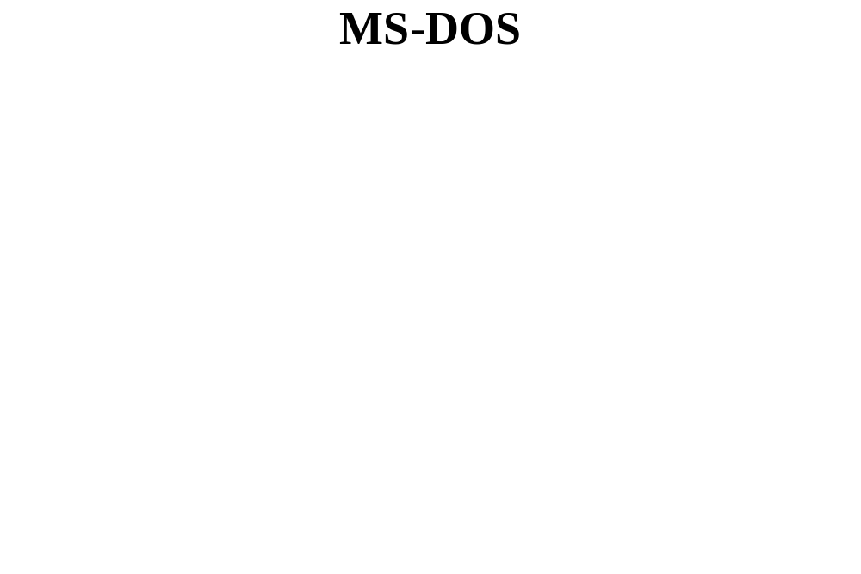

Slide 2
History
Development purpose
  Single-user, stand-alone desktop computers
Manages single user jobs sequentially
Advantages
  Fundamental operation
  Straightforward user commands
Disadvantages
  Lack of flexibility
  Lack of ability to meet programmer and experienced user needs

Slide 3
History (cont'd.)
CP/M operating system successor
  CP/M ran first eight-bit machines
Microsoft
  Discovered 86-DOS
    Designer: Tim Patterson (Seattle Computer Products)
  Microsoft bought and renamed 86-DOS to MS-DOS
    Available to IBM
IBM renamed MS-DOS to PC-DOS (1981)
  Catalyst for MS-DOS growth
  Standard for IBM PCs throughout 1980s
    16-bit machines

Slide 4

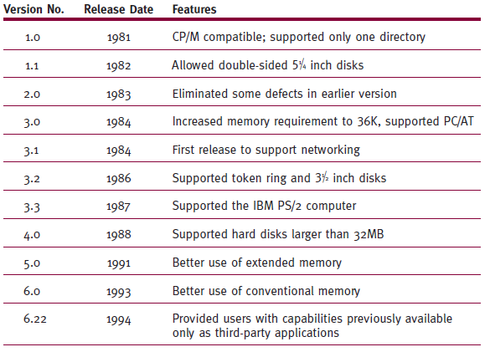
History (cont'd.)

Slide 5
History (cont'd.)
Many standard versions over years
  Later versions compatible with earlier versions
  Commands
    Manufacturer independent
Early Windows versions (1.0 - 3.1)
  GUIs on top of MS-DOS
Today
  MS-DOS no longer widely used
  Windows offers DOS emulator

Slide 6
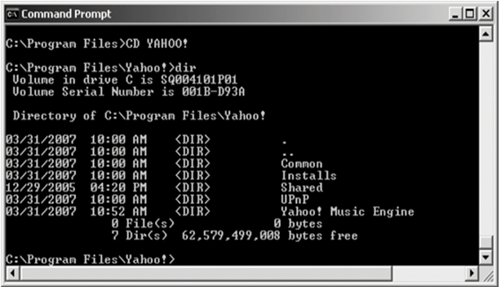
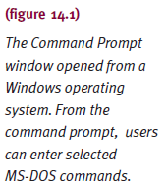
History (cont'd.)

Slide 7
Design Goals
Accommodate single novice user
  In single-process environment
Standard I/O support
  Keyboard, monitor, printer, secondary storage unit
User commands
  Based on English words or phrases
  Indicative of action to perform
  Interpreted by command processor
Layering approach
  Fundamental to MS-DOS system design

Slide 8
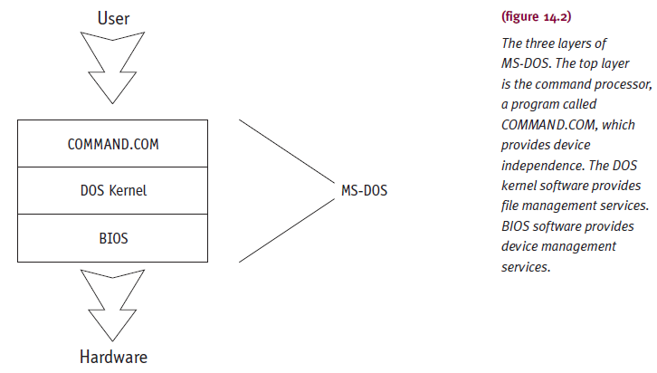
Design Goals (cont'd.)

Slide 9
Design Goals (cont'd.)
BIOS (Basic Input/Output System)
  Direct interface with I/O devices
  Contains device drivers
    Controls data flow to and from each device (except disk drives)
  Receives I/O operation status information
    Passes to processor
  Handles small differences among I/O units
    No need to write device driver for manufacturer printer

Slide 10
Design Goals (cont'd.)
DOS kernel
  Contains routines to interface with disk drives
  Read into memory
    Initialization time from MSDOS.SYS file
    Resides in boot disk
  Microsoft proprietary program
  Accessed by application programs
  Provides hardware-independent services
    System functions
    Memory management, file and record management

Slide 11
Design Goals (cont'd.)
DOS kernel (cont'd.)
  Provides transparency
    Compensates for manufacturer variations
  Manages file storage and retrieval
  Dynamically allocates and deallocates secondary storage as needed

Slide 12
Design Goals (cont'd.)
Command processor (shell)
  Sends prompts to user
  Accepts typed commands
  Executes commands
    From system prompt
    Issues appropriate responses
  Resides in COMMAND.COM file
    Stored in two different main memory sections
  Appears on public directory
  Weakness: not interpretive

Slide 13
Design Goals (cont'd.)
MS-DOS Version 4
  Introduced menu-driven shell
  Not widely accepted
OS/2
  New operating system
  Designed with advantages to replace MS-DOS
  Not widely accepted
MS-DOS hey day
  Ran variety of software (Lotus 1-2-3, WordPerfect)
  Spurred growth of personal computer industry

Slide 14
Memory Management
Memory Manager
  Manages single job for single user
  For second job execution
    User must close or pause first before opening second
  First-fit memory allocation scheme
    Efficient in single-user environment

Slide 15
Memory Management (cont'd.)
Main memory structure
  ROM
    Very small in size
    Contains program
    Contains section of BIOS with startup process (bootstrapping)
    Initializes computer
    Retrieves resident code and loads into RAM
  RAM
    Part of main memory
    Where programs are loaded and executed

Slide 16
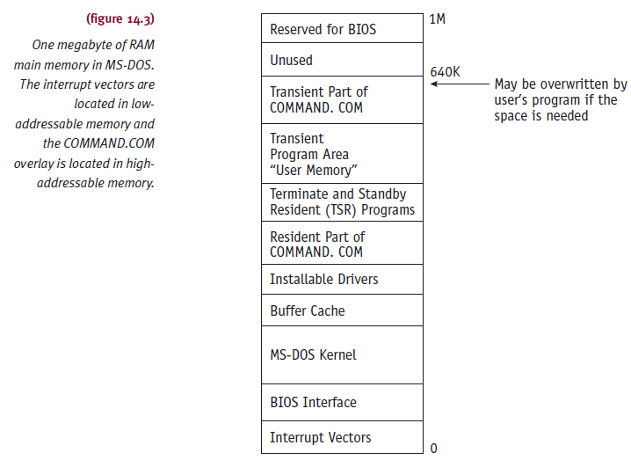
Memory Management (cont'd.)

Slide 17
Main Memory Allocation
MS-DOS Version 1.0
  All available memory to resident application program
MS-DOS Version 2.0
  Application programs
    Dynamic allocation support
    Main memory blocks modification and release
Application program memory ownership dependencies
  Type of file from which program loaded
  Size of Transient Program Area (TPA)

Slide 18
Main Memory Allocation (cont'd.)
Programs
  COM extension
    Given all TPA (needed or not)
  EXE extension
    Given memory needed (if available)
TPA
  Any number of programs (except COM files)
  Two programs cannot run simultaneously
Memory allocation
  Shrinking and expanding during execution
  Requires C or assembly language

Slide 19
Memory Block Allocation
Memory allocation
  First-fit algorithm and linked list of memory blocks
Best-fit or last-fit strategy
  Version 3.3 and beyond
  Last-fit
    Allocates highest addressable memory block satisfying program’s request
Block size varies
  Small: 16 bytes ( “paragraph”)
  Large: maximum available memory

Slide 20
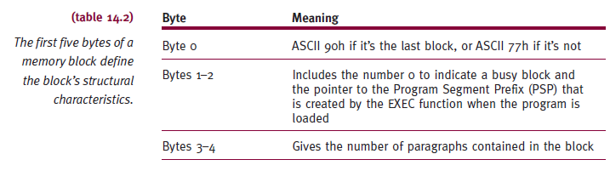
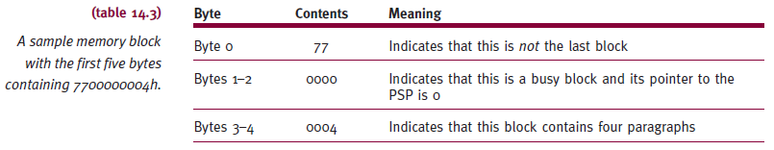
Memory Block Allocation (cont'd.)

Slide 21

Memory Block Allocation (cont'd.)
Memory request steps
  DOS looks through free/busy block list
    Until finding free block fitting request

Slide 22
Memory Block Allocation (cont'd.)
Disconnected list
  Error message issued
  System stops
  Reboot necessary
Well-designed application program
  Releases memory block no longer needed
Two contiguous free memory blocks
  Immediately merged into one block and linked to list

Slide 23
Processor Management
Simple task
Job read for execution
  Allocate processor to resident job

Slide 24
Process Management
Reentrant code
  Basis for multitasking
    Not supported
No interleaving
  No need for sophisticated algorithms or policies
Jobs
  Run in complete segments
  Not interrupted midstream
Illusion of multitasking
  Uses synchronization and interrupt handlers

Slide 25
Interrupt Handlers
Responsibility
  Synchronizing (parent and child processes)
  Saves all parent program information
    Allows proper restart after child program finished
Personal computer
  256 interrupts and interrupt handlers
  Accessed through interrupt vector table (RAM)
Interrupts divided into three groups
  Internal hardware interrupts
  External hardware interrupts
  Software interrupts

Slide 26
Interrupt Handlers (cont'd.)
Internal hardware interrupts
  Generated by events occurring during program’s execution
    Division by zero
  Event assignment to specific interrupt numbers
    Electronically wired into processor
  Not modifiable by software instructions

Slide 27
Interrupt Handlers (cont'd.)
External hardware interrupts
  Cause
    Peripheral device controllers or coprocessors
  External device assignment to specific interrupt levels
    Done by manufacturer
  Cannot be modified by software
    Physical electrical connection implementation
Software interrupts
  Generated by system and application programs
  Access DOS and BIOS functions

Slide 28
Interrupt Handlers (cont'd.)
Software interrupts (cont'd.)
  Some activate specialized application programs
    Take control of computer
    Example: Borland’s SideKick (type of TSR)
  Terminate and Stay Resident (TSR) interrupt handler
    Terminates process without releasing memory
    Used by subroutine libraries
    Sets up memory tables
    Execution preparation via DOS interrupt connection
    Determines memory required
    Sends return code back to parent

Slide 29
Interrupt Handlers (cont'd.)
Interrupt synchronization
  CPU senses interrupt
    Puts on stack: contents of PSW (program status word), code segment register, and instruction pointer register
    Disables interrupt system
    Uses eight-bit number to obtain interrupt handler address
    Interrupt handler reenables interrupt system: allows higher-priority interrupts to occur
    Saves registers and processes interrupt

Slide 30
Device Management
Requests
  Reordering requests: not supported
  Handled: first-come, first-served
  BIOS supports spooling (Version 3.0)
MS-DOS
  Written for simple systems
    Keyboard, monitor, printer, mouse, serial ports,
  Personal computer storage
    Magnetic tape, floppy disks, or hard disks
  No device channels

Slide 31
Device Management (cont'd.)
MS-DOS (cont'd.)
  Devices have dedicated control unit
    Only requires device driver
Device driver
  Software module controlling I/O device
BIOS
  Portion of Device Manager
  Handles device driver software
Installable device drivers
  Salient feature of MS-DOS design

Slide 32
File Management
File organization
  Sequential
    Variable or fixed-length records
  Direct
    Fixed-length records
  Indexed sequential
    Fixed-length records

Slide 33
Filename Conventions
Filename
  No spaces
  Drive designation, directory, any subdirectory, a primary name, and optional extension
  Not case sensitive
Drive name: followed by colon (:)
Directories or subdirectories
  One to eight characters
  Preceded by a backslash (\)
Primary filename: one to eight characters

Slide 34
Filename Conventions (cont'd.)
Extension
  One to three characters
  May have special meaning
File
  Assumption: in current working directory
    If no directories or subdirectories included in name
  On current drive if no drive designated
Relative name
  Primary name and extension
Absolute name
  Drive designation and directory location

Slide 35
Managing Files
Earliest versions
  Every file in single directory
  Slow and cumbersome file retrieval
Hierarchical directory structure (version 2.0)
  Inverted tree directory structure (root at top)
Formatting
  Disk tracks divided into 512-byte sectors
  Corresponds to 512-byte buffer size
Cylinder concept
  Applies to hard disks
    Read/write heads move in unison

Slide 36
Managing Files (cont'd.)
Sectors
  Two to eight
  Grouped into clusters
  File needs additional space
    DOS allocates more clusters
FORMAT command
  Three special areas on disk
    Boot record
    Root directory
    FAT(file allocation table)

Slide 37
Managing Files (cont'd.)
Boot records
  First sector of every logical disk
    Disk boot program
    Table of disk’s characteristics
Root directory
  System begins interaction with user
    List of system’s primary subdirectories and files
    Any system-generated configuration files
    Any user-generated booting instructions

Slide 38
Managing Files (cont'd.)
Root directory (cont'd.)
  AUTOEXEC.BAT file
    Batch file containing user-defined command series
    Commands execute automatically (CPU power up)
  Root directory information
    Filename, file extension
    File size in bytes
    Date and time of file’s last modification
    Starting cluster number for file
    File attribute codes

Slide 39
Managing Files (cont'd.)
Root directory (cont'd.)
  Limitation
    Number of root directory entries fixed
  Version 2.0 and onward
    Limitation avoided with subdirectories
  Subdirectory
    May contain its own subdirectories and/or files
  MS-DOS supports hidden files
    Executable files not displayed in DIR command listing
    COMMAND.COM (only system file not hidden)

Slide 40
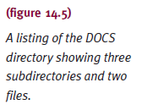
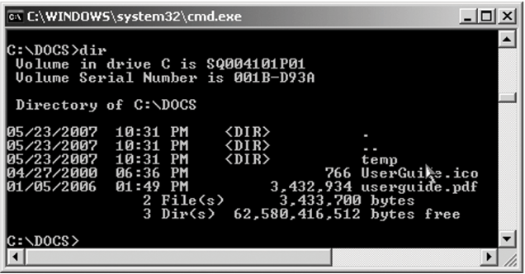
Managing Files (cont'd.)

Slide 41
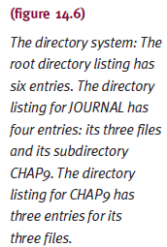
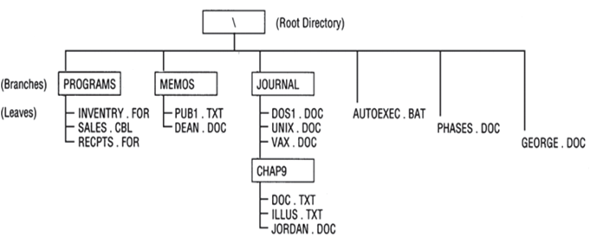
Managing Files (cont'd.)

Slide 42
Managing Files (cont'd.)
File allocation table (FAT)
  Contains disk sectors’ status information
  Status includes:
    Allocated sectors, free sectors, unallocatable sectors (formatting errors)
  All sectors (except first) chain linked
    Each FAT entry: sector/cluster number of next entry
    Last entry contains value set to FF
    FF indicates chain end

Slide 43
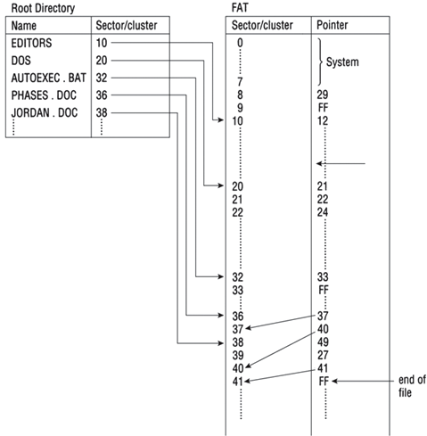
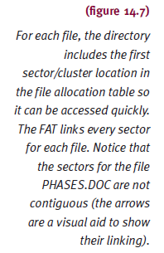
Managing Files (cont'd.)

Slide 44
Managing Files (cont'd.)
MS-DOS data views
  Disk file: continuous string of bytes
  I/O operation data request
    By relative byte (relative to file beginning)
    Not a relative sector
Supports noncontiguous file storage
Dynamically allocates file disk space
Compaction: DEFRAG.EXE inclusion (Version 6.0)
  CHKDSK: file storage noncontiguous block count
Security features not included

Slide 45
User Interface
MS-DOS
  Command-driven interface
System prompt
  User types commands
Default prompt
  Drive indicator and > character
  Changed using PROMPT command
User command elements
  Command, source-file, destination-file, switches

Slide 46
User Interface (cont'd.)
Switches (optional)
  Provide details on how command carried out
  Begin with slash (/P, /V, /F)
COMMAND.COM (carries out commands)
  Resident portion of code
    Stored in low memory section
    Command interpreter, routines: support active program
  Transient code
    Stored in highest memory addresses
    Can be overwritten if memory space needed

Slide 47
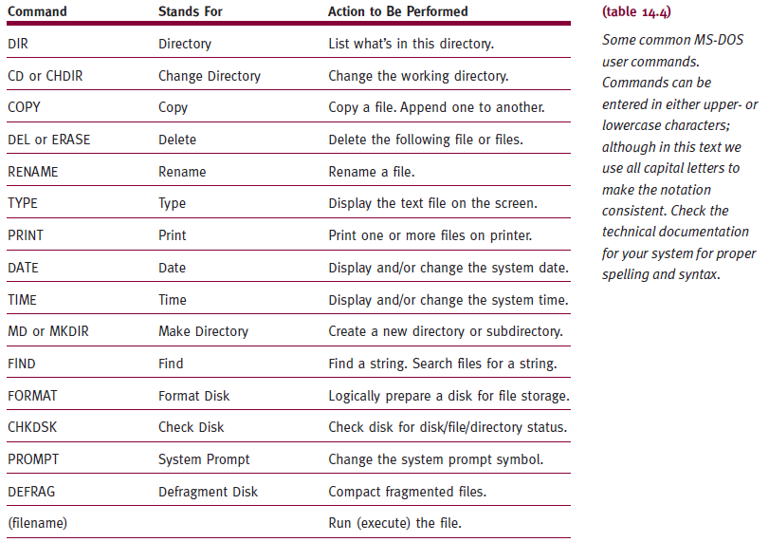
User Interface (cont'd.)

Slide 48
Batch Files
Customized
  Allows quick DOS command execution
    Configure system
    Perform routine tasks
    Easier to run software (nontechnical users)
Run manually
  Use START command at system prompt
Run automatically (at system start)
  Rename file to AUTOEXEC.BAT
  Load into system root directory

Slide 49

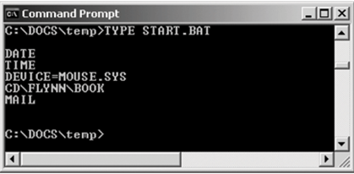
Batch Files (cont'd.)

Slide 50
Redirection
Redirect output
  From one standard input or output device to another
Syntax: command > destination
  Example: DIR > PRN
    Sends directory listing to printer (instead of monitor)
Append symbol (>>)
  Redirect and append new output to existing file
  Example: DIR >> B:DIRFILE
Works in opposite manner
  Symbol (<) changes source to specific device or file
  Example: INVENTRY < B:TEST.DAT

Slide 51
Filters
Commands
  Accept default device input, manipulate data, send results to default output device
  Example: SORT
    Accepts input and displays on screen
    Accepts file input and sorts into another file (redirect)
    Ascending order:
    SORT < STD.DAT > SORTSTD.DAT
    Reverse order file: SORT /R
  Example: MORE
    Output displayed on screen in groups of 24 lines
    One screen at time (press Enter key)

Slide 52
Pipes
Command output
  Input to another command
Symbol
  Vertical bar (|)
  Example: DIR | SORT
    Alphabetically sort directory
    Display sorted list on screen
Can combine pipes and other filters
Can sort directory and display one screen at a time
  Example using pipe command
    DIR | SORT | MORE

Slide 53
Additional Commands
FIND
  Searches for specific string in given file(s)
  Displays all lines containing string
  Example: FIND "AMNT-PAID" PAYROLL.COB
    Display PAYROLL.COB lines containing AMNT-PAID
PRINT
  Set up series of files for printing
  Frees up COMMAND.COM
  PRINT /B: allows changing of internal buffer size
  PRINT /Q: specifies number of files allowed in print queue

Slide 54
Additional Commands (cont'd.)
TREE
  Displays directories and subdirectories
  In hierarchical order and indented list
  Options allow file deletion while tree generated
  TREE /F
    Displays filenames in each directory
    Used to delete duplicated file on different directories

Slide 55

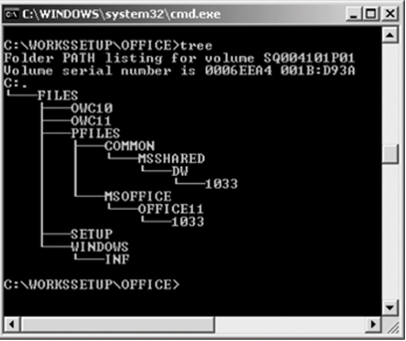
Additional Commands (cont'd.)

Slide 56
Summary
MS-DOS
  Written to serve 1980s personal computer users
Limitation
  Limited flexibility
  Operating system unusable as hardware evolved
First standard operating system
  Adopted by personal computing machine manufacturers
  Supported by legions of software design groups

Slide 57
Summary (cont'd.)
Advantages
  Fundamental operation
  Straightforward user commands
Weakness
  Design
    Single-user/single-task systems
  No multitasking, networking, sophisticated applications support

